Slide 1
ML Ontology solution for Blood Donation System
Final Year Project

Slide 2
Department of Computer Sciences
FYP - Details
Guided By:
Ma’am Sana Rizwan
FYP Serial No:
FA22SE13

Slide 3
Our Team
Akash Ur Rehman
FA19-BSE-112
Muhammad Abu Hurairah
FA19-BSE- 033
Muhammad Salman Ahmed
FA19-BSE- 098

Slide 4
Introduction
Implementation of the Blood Donation System through ML & Ontology.
Automation of the Manual system to decrease the workload of Blood Banks.
Using Ontological Concepts with Machine Learning as it improves the data quality for training the datasets.
A motto of arranging the blood on time to save Precious Lives.
Welfare For ALL!

Slide 5

Benefits
Helping the People in Critical circumstances.
No Hassle regarding the Donations or Blood Queries because of automation of the system.
Book and Appointment while being at your places.
Get Your Appointment Details through the website.
Helping to Identify the eligibility for the donation.
Connect with the donor if stock is not available.
Save Time. Save Lives!

Slide 6
Functional Requirements
Login
Registration
Make the request for Blood
Donate Blood
Check Eligibility of User For Blood Donation
View Blood Donation Centers
Generate Appointment Report
Display User Profile

Slide 7
Functional Requirements (Cont)
View Blood Requests
Update Personal Information
Delete Personal Information
Get User Feedback
Add User Information
Generate Report of Blood Stocks
Update Blood Stock

Slide 8
Functional Requirements (Cont)
Download Weekly/Monthly Appointment Reports
Manage NGO’s or Blood Donation Centers
Add News
Manage Advertisement
Handling Blood Request
Managing Enquiries
Managing User’s Personal Information

Slide 9
Functional Requirements (Cont)
Managing Campaigns
Managing Donor List
Manage Sponsors
Manage Financial Donations
Manage Job Posts
Managing Frequently asked Questions

Slide 10
Consoles
01
02
Admin
User
03
04
Blood Donation
Center
Labs

Slide 11
Related Work
Haemoglobinopathies in India: estimates of blood requirements and treatment costs for the decade 2017-2026,”
Journal of community genetics, vol. 11, no. June,11, pp. 39-45, 2020.
In this study, it is explore that collecting blood from the donor and making it available for different types of patients (thalassemia patients, cancer patients, etc.). Now, Pakistan Health Organizations (PHO) is providing facilities to patients to save their lives in any emergency.

Slide 12
Related Work
“Profiling blood donors in Egypt: A neural network analysis, Expert system with Applications “
vol. 36, no. 2009, pp. 5031-5038, 2009.
Blood is needed in emergency as well as routine operations like medical disease (cancer), heart bypass, etc. Different models such as Multi-layer perceptron neural network (MLP) and probabilistic neural network (PNN) models are used for predicting the values.

Slide 13
Related Work
A Research Paper on Blood Donation Management
Blood shortage has been an ever-serious issue throughout the world. Natural science progresses has raised the blood demand significantly. This issue motivates us to build or grow the system that will help people in an emergency.

Slide 14
Related Work
People fear for Blood Donation
Positivity might be encouraged and negativity could be reduced. Positive Altruism informed their blood donation philosophy. In 56% of cases, a desire to assist others, along with other favourable family and friend motivation was a source of reinforcement (28%) and (16%) Religious organisations.

Slide 15
Related Work
Relationship between religion and blood transfusion habits
Young people make up the bulk of the population of Pakistan. Our investigation revealed that the study group's average age was 21.84 years, falling within the expected range of 20 to 25 years. Given that the majority of participants were Muslims, the current study did not examine the relationship between religion and blood transfusion habits in great detail.

Slide 16
Related Work
A Research Paper on ontology Learning
Zhou: Ontology learning: state of the art and open issues - Google Scholar
Zhou released a paper in 2007 that provided a thorough overview of the outstanding problems and difficulties in ontology learning and detailed illustrations of the process of ontology learning.

Slide 17
Related Work
Blood Donor Classification Using Neural Network and Decision Tree Techniques
Data is gathered through an online questionnaire to check that donor will able to donate blood or not when required. Different type of data is gather for the machine learning techniques to categorize the donors into liable or not. Artificial neural networks and decision tree techniques are adapted to predict from the series of questions whether each individual is liable for blood donation or not.

Slide 18
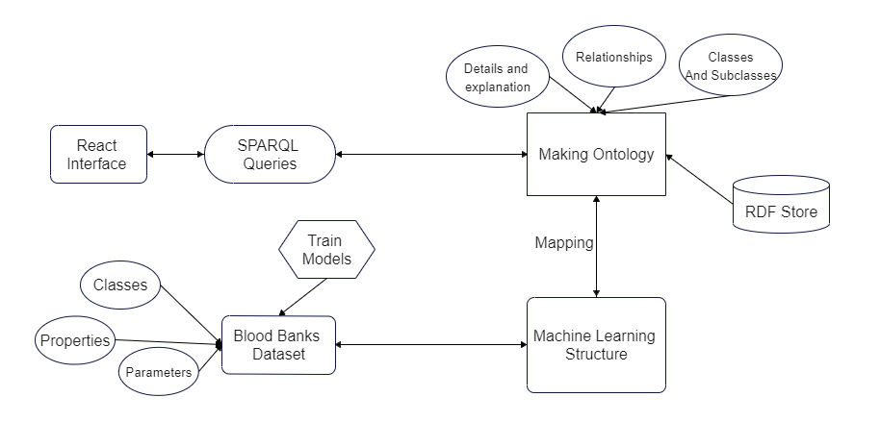
System Architecture Diagram

Slide 19
Tools, Languages and Editors
Tools
Languages
React
Protégé
NodeJS
Express
MongoDB
Python
Ontology
Java Spring
HTML
CSS
JavaScript
Sparql
Web Ontology language
Python
ReactJS
Editors
Visual Studio Code (VS Code)

Slide 20
Work Breakdown Structure (WBS)

Slide 21
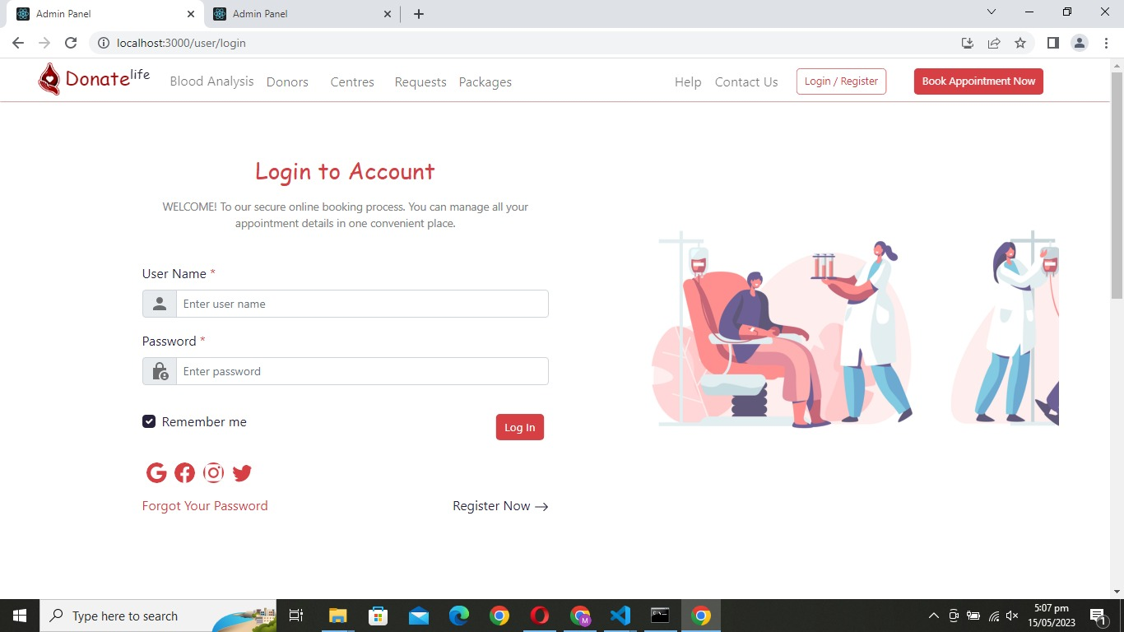
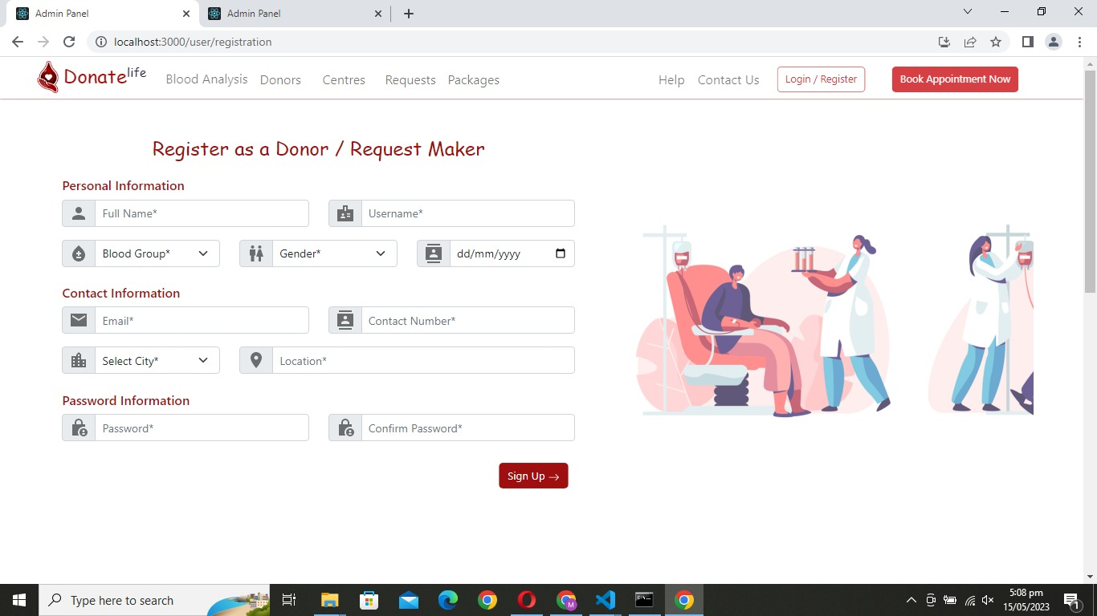
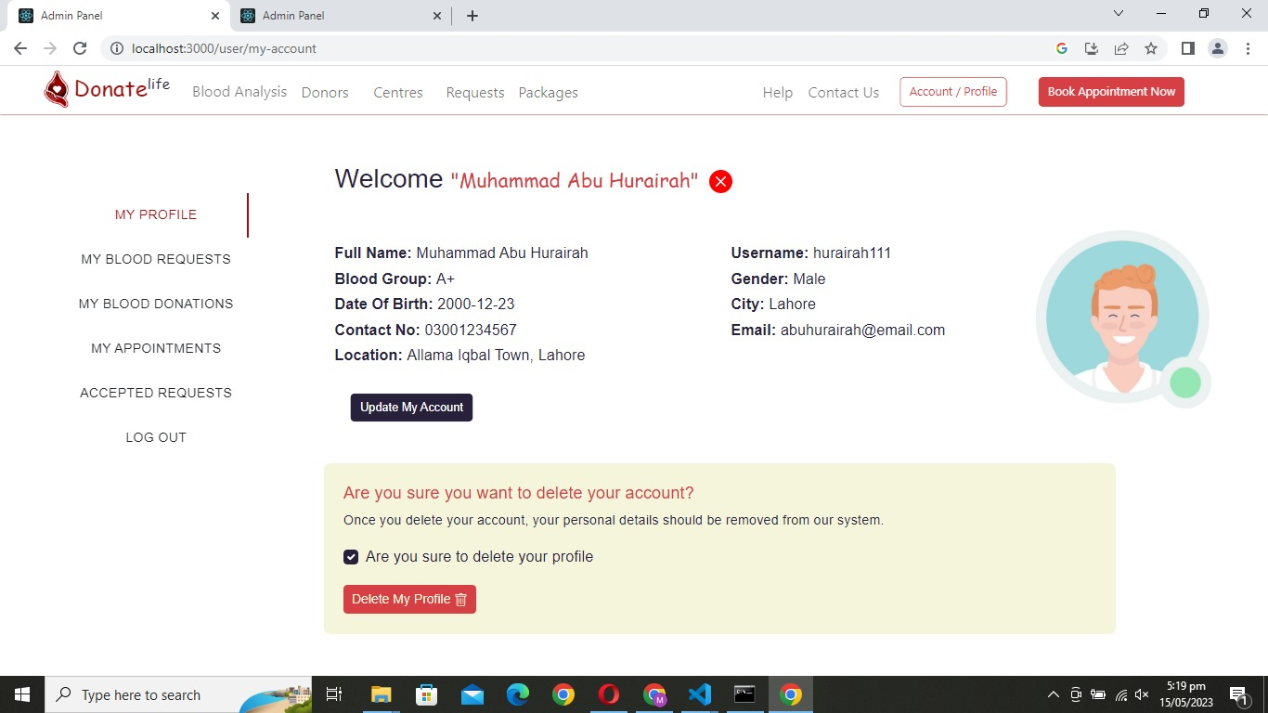
High Fidelity Prototypes
User Panel

Slide 22
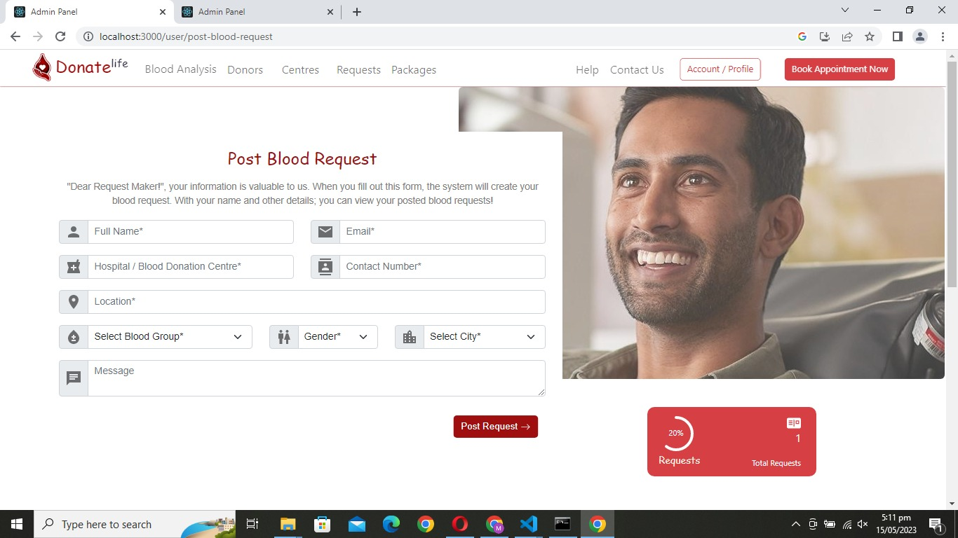
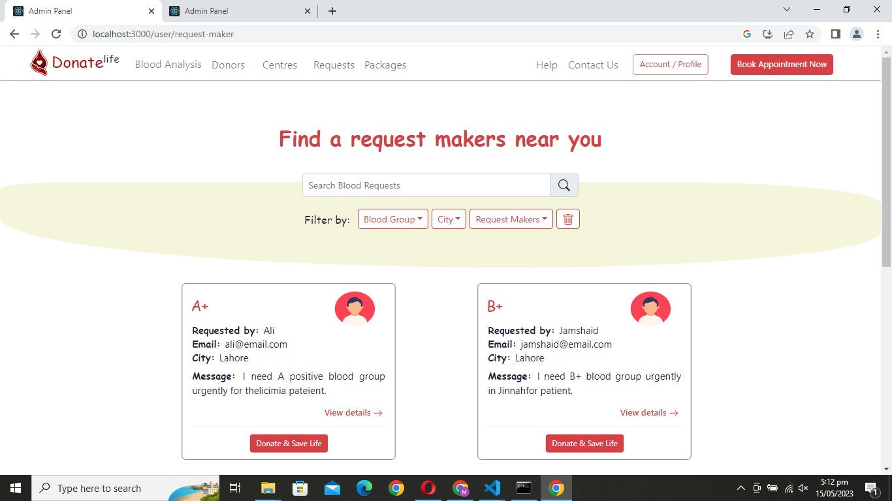
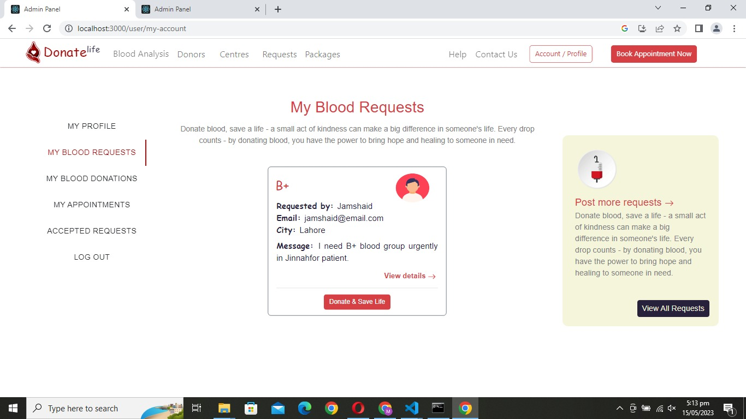
High Fidelity Prototypes
User Panel

Slide 23
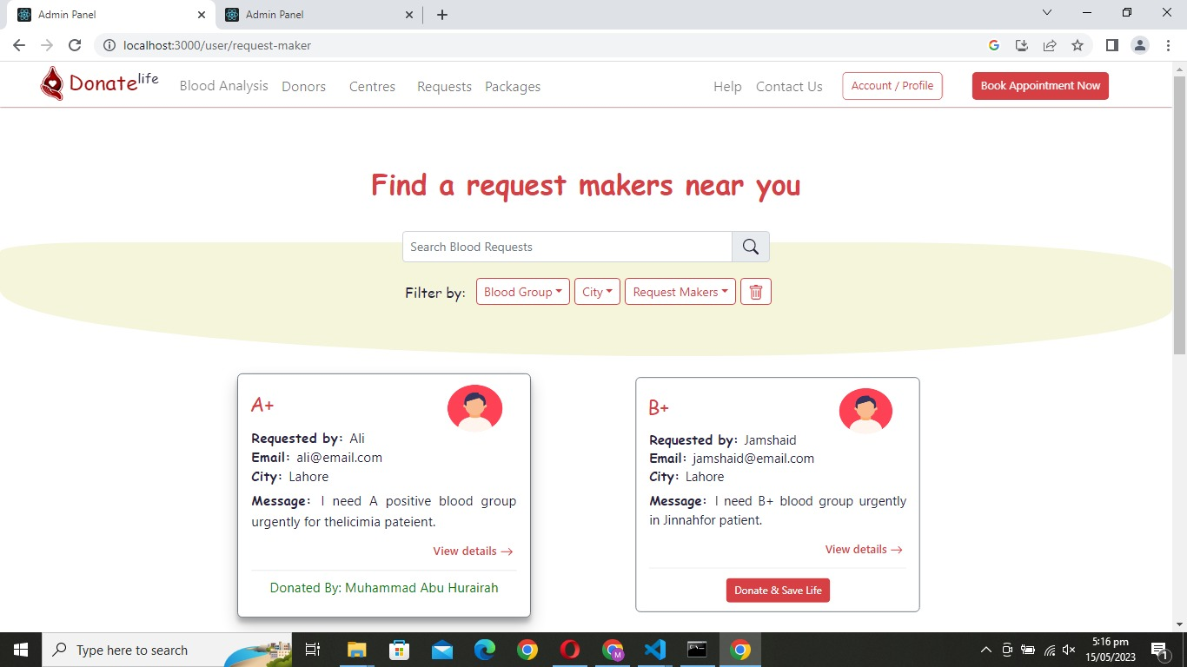
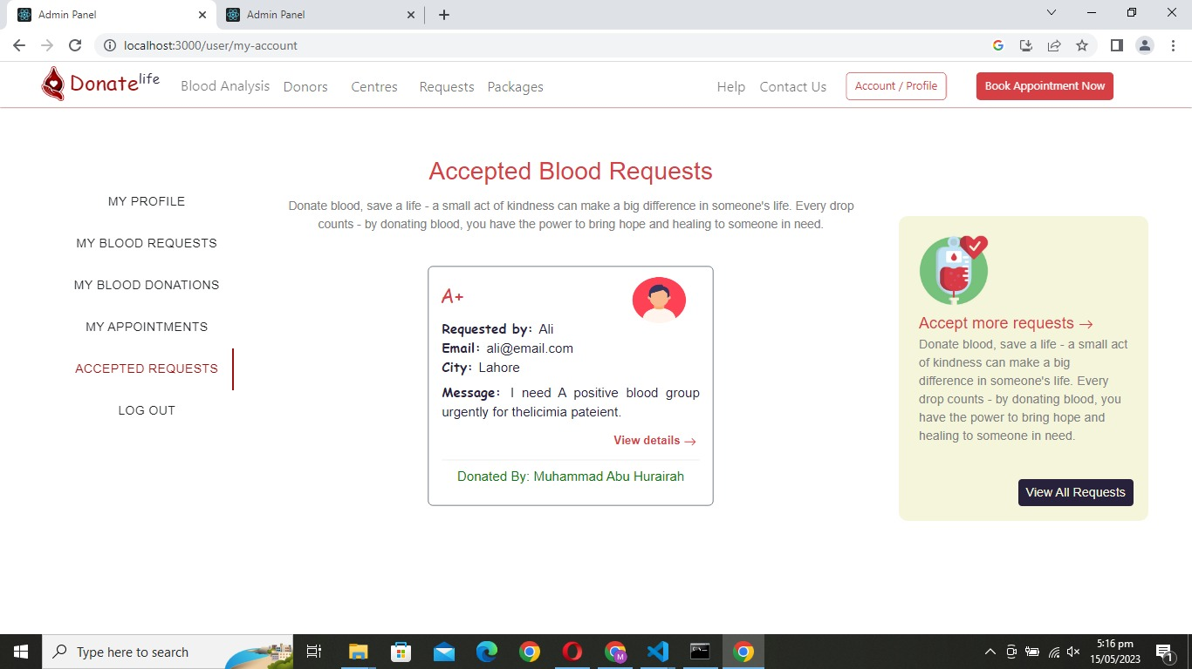
High Fidelity Prototypes
User Panel

Slide 24
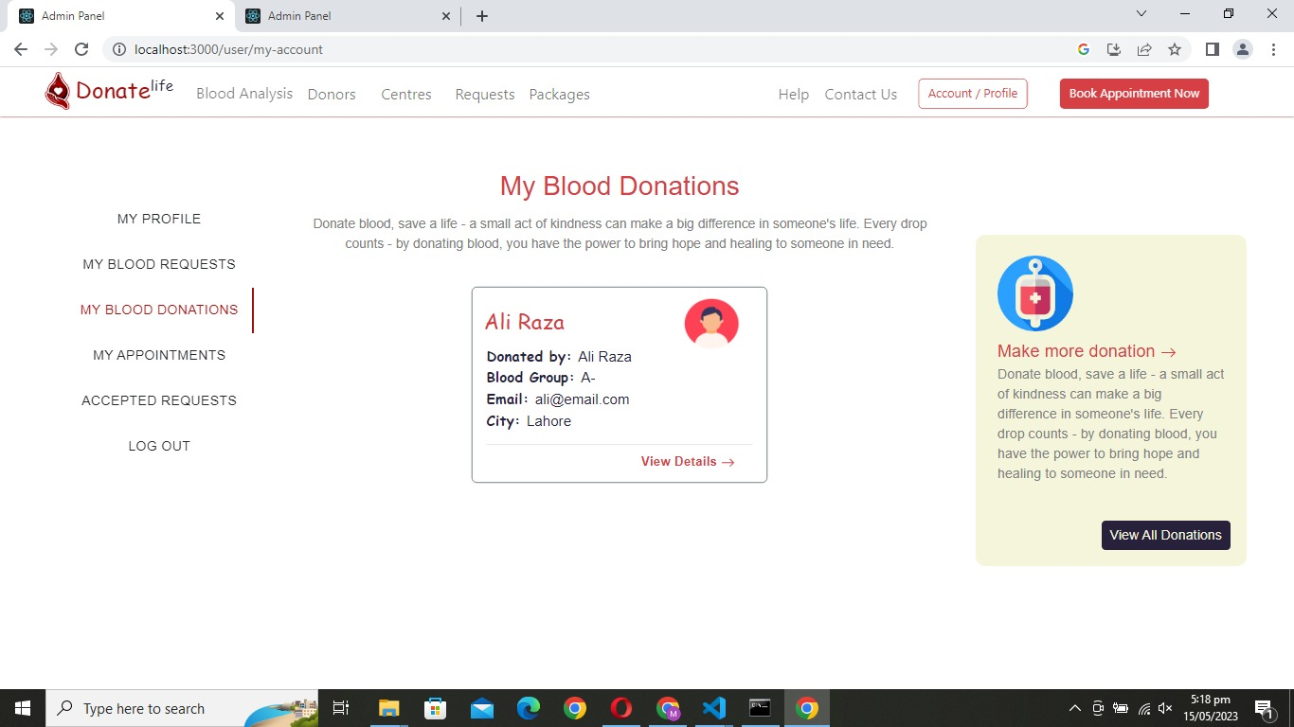
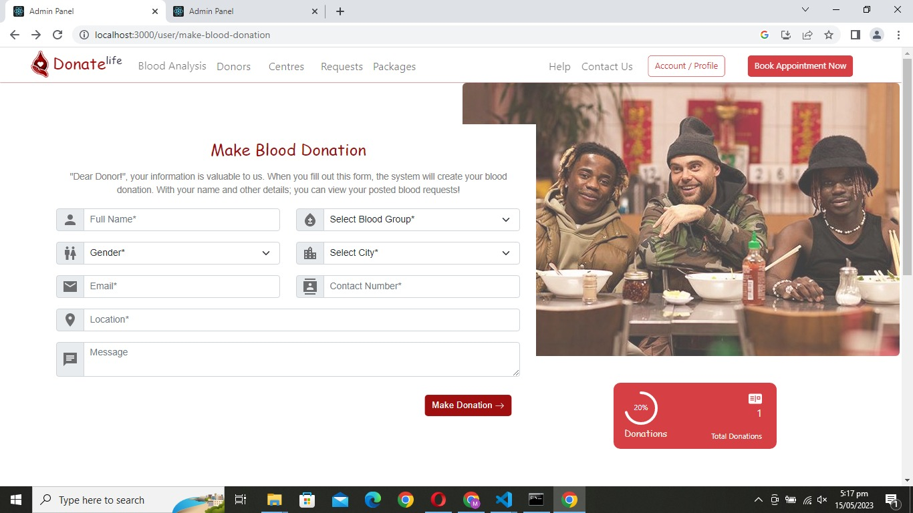
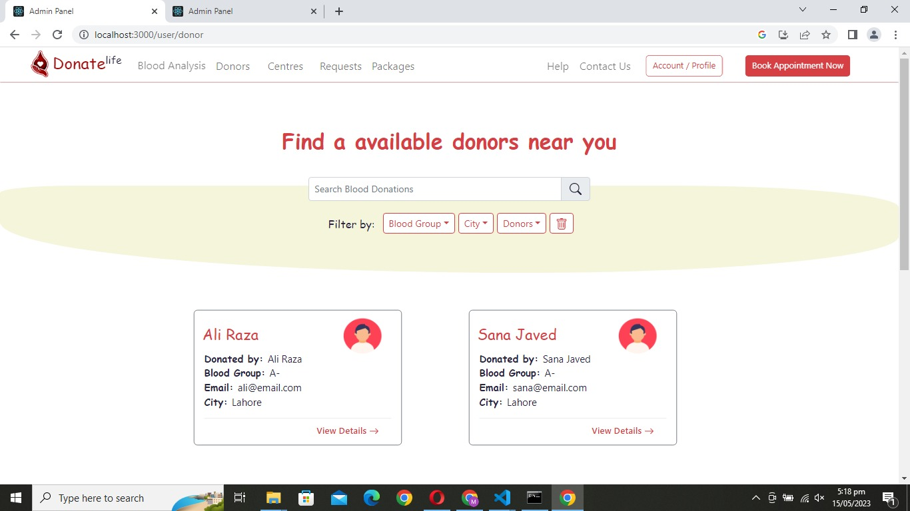
High Fidelity Prototypes
User Panel

Slide 25
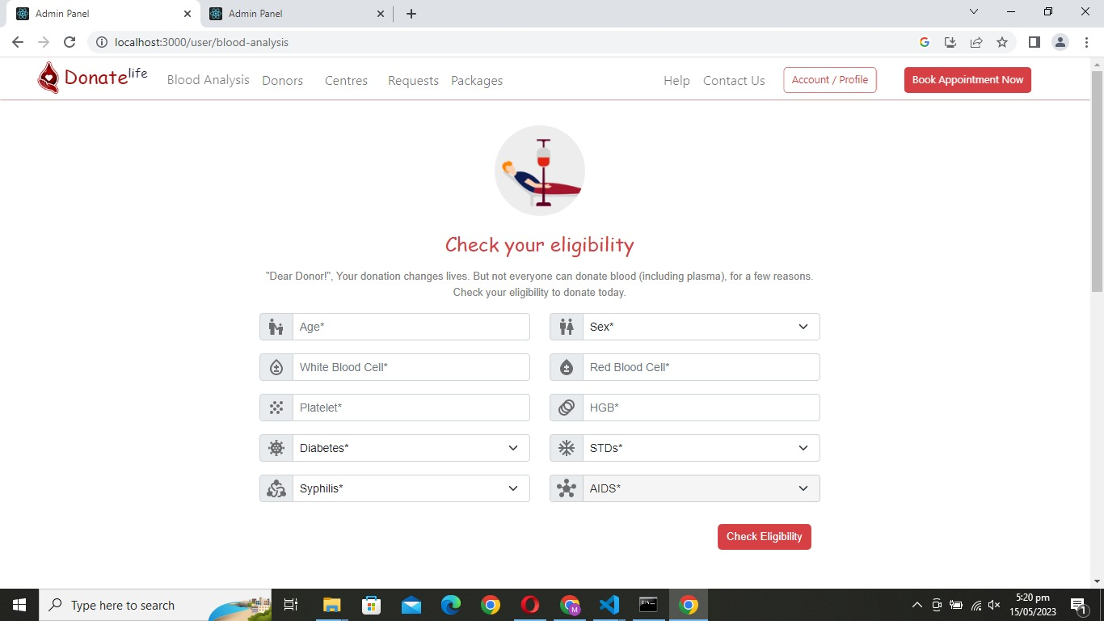
High Fidelity Prototypes
User Panel

Slide 26
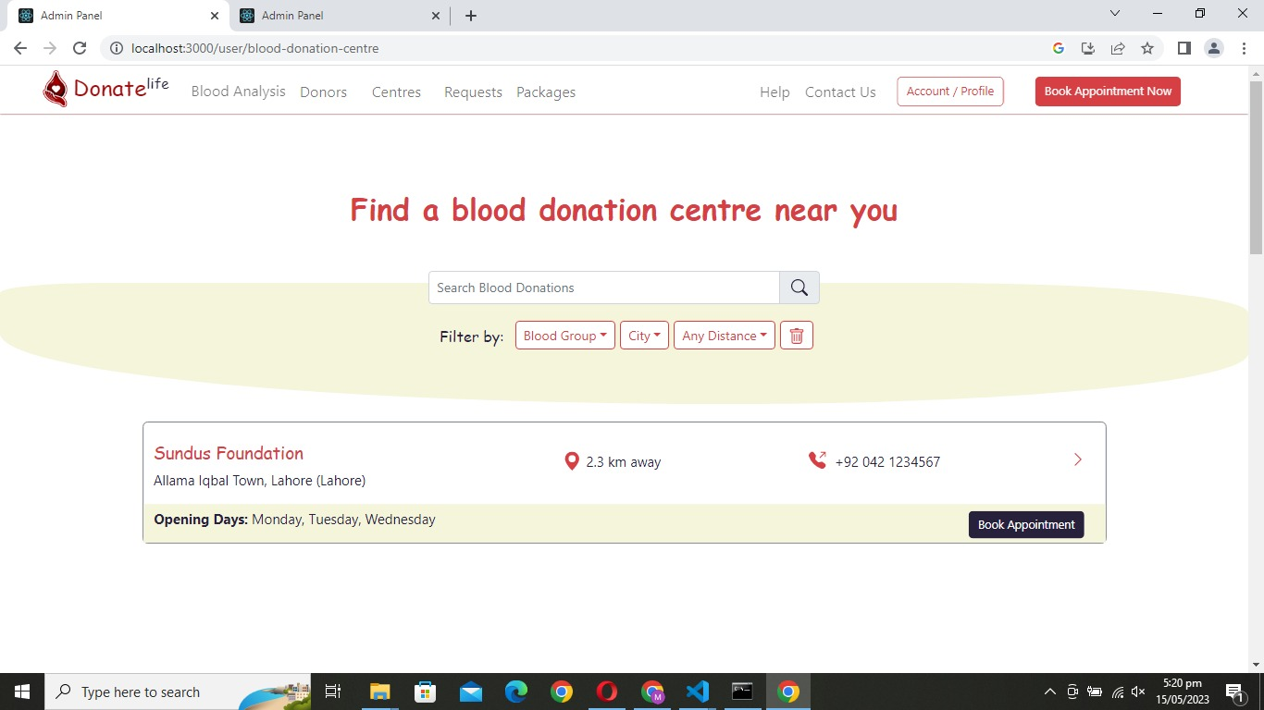
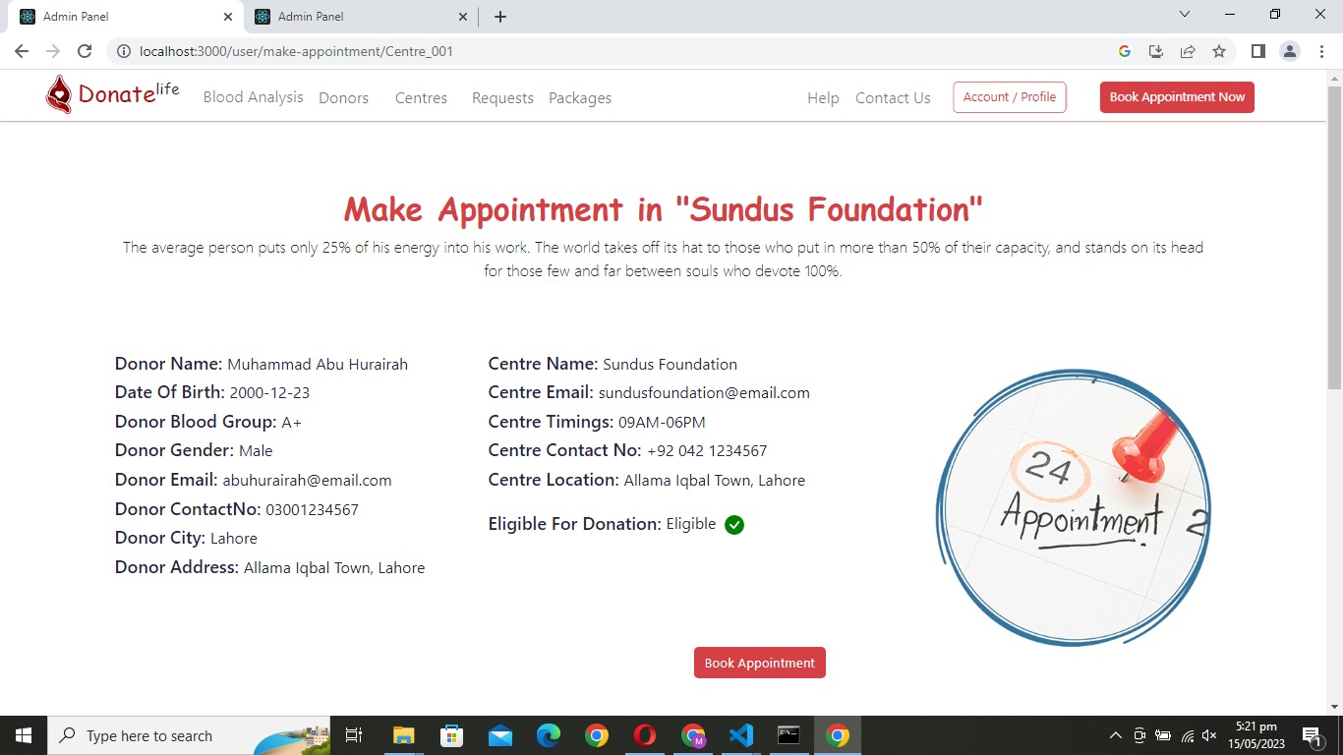
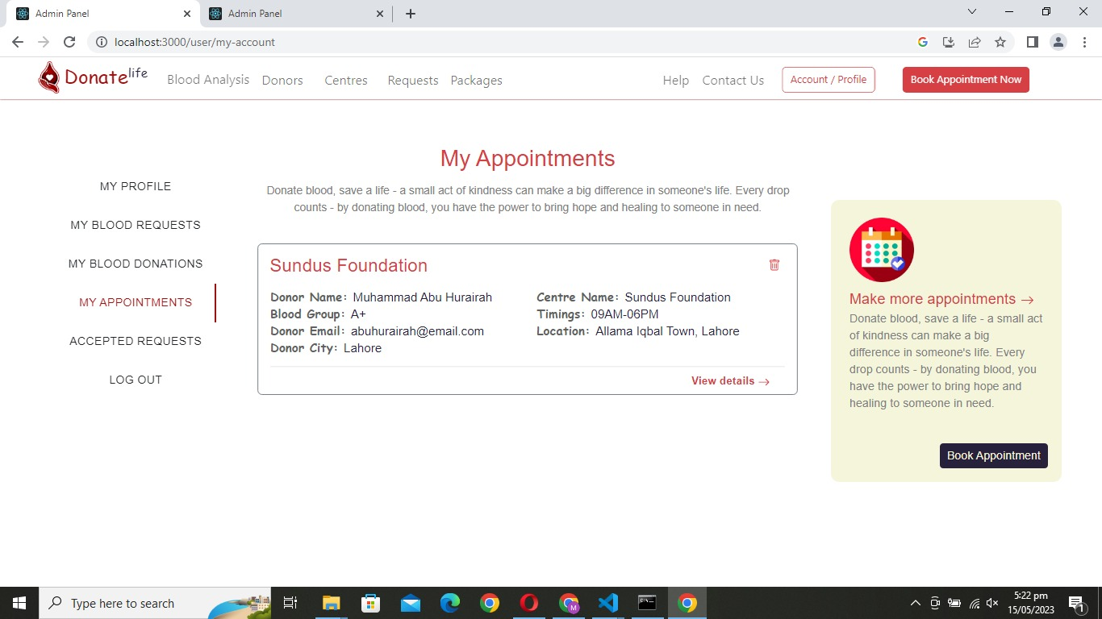
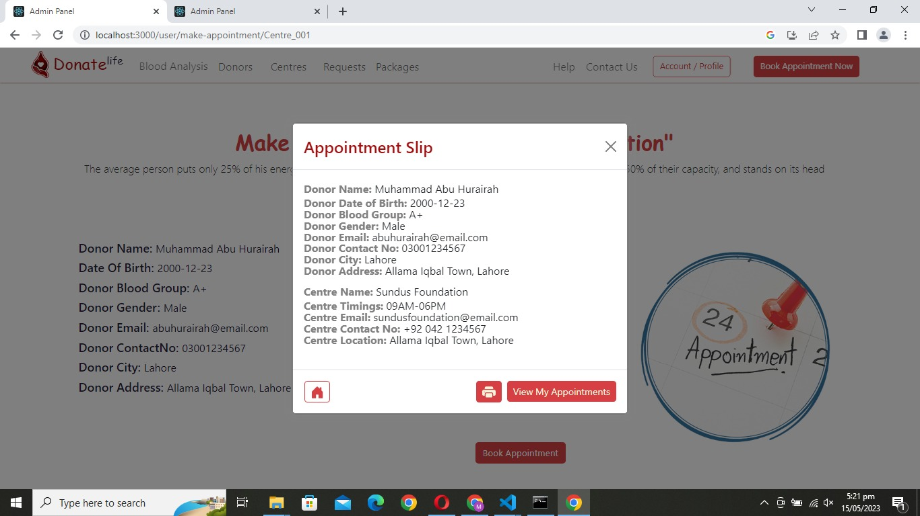
High Fidelity Prototypes
User Panel

Slide 27
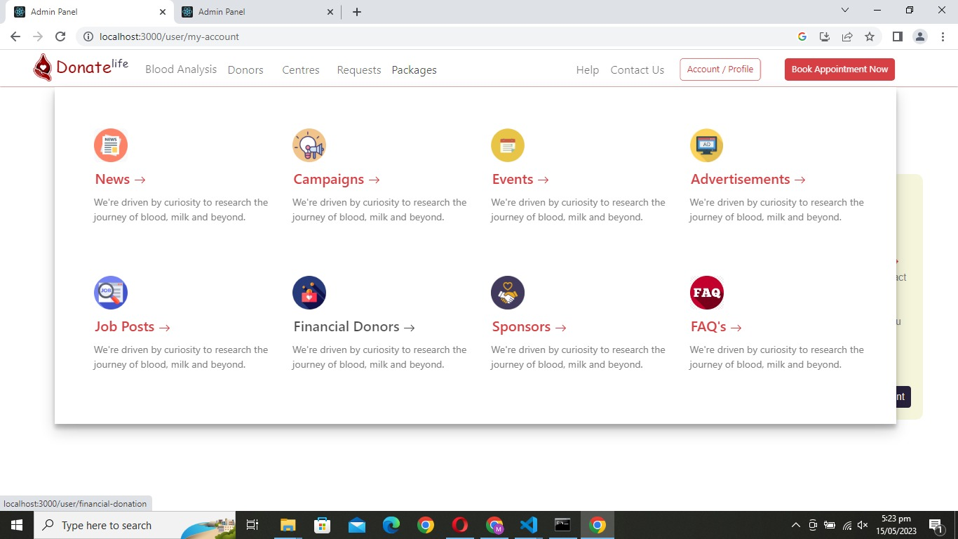
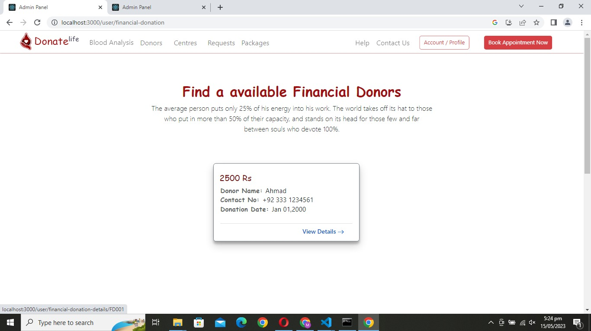
High Fidelity Prototypes
User Panel

Slide 28
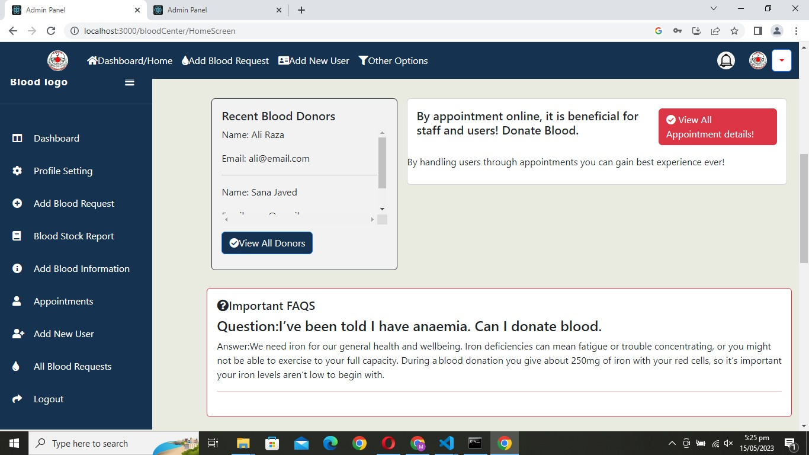
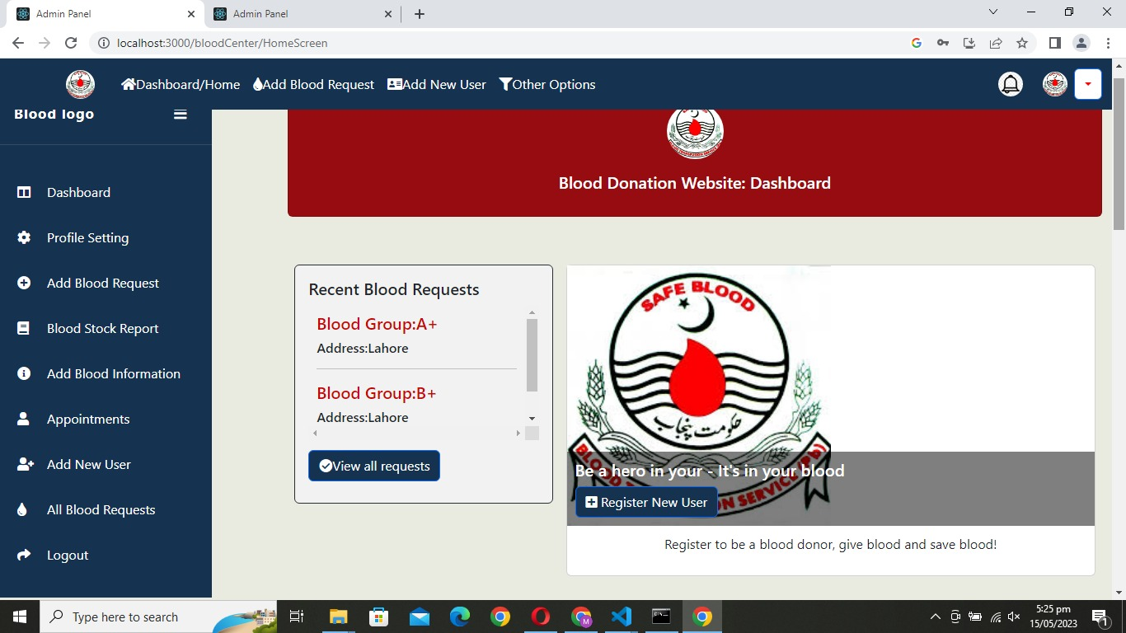
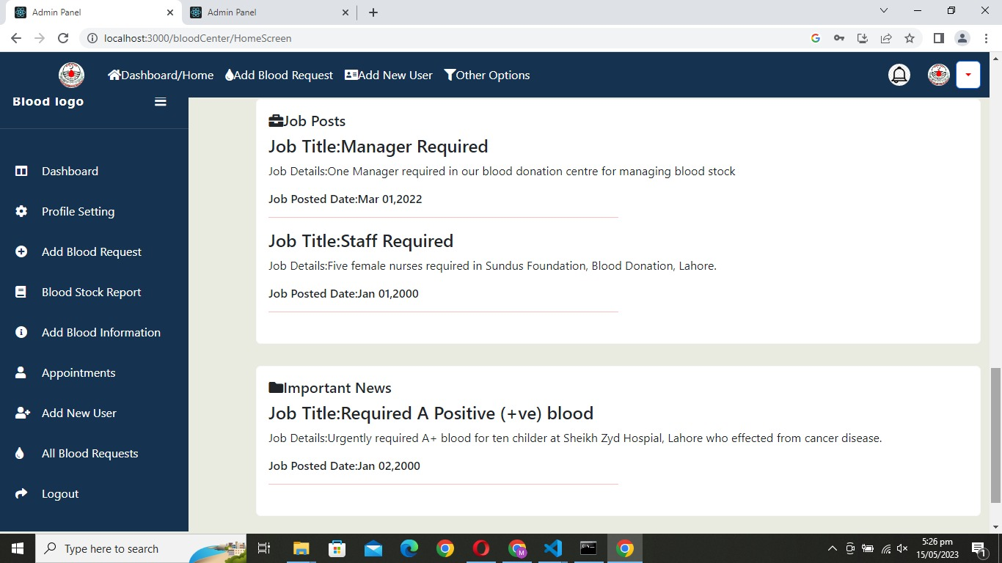
High Fidelity Prototypes
Blood Donation Centre Panel

Slide 29
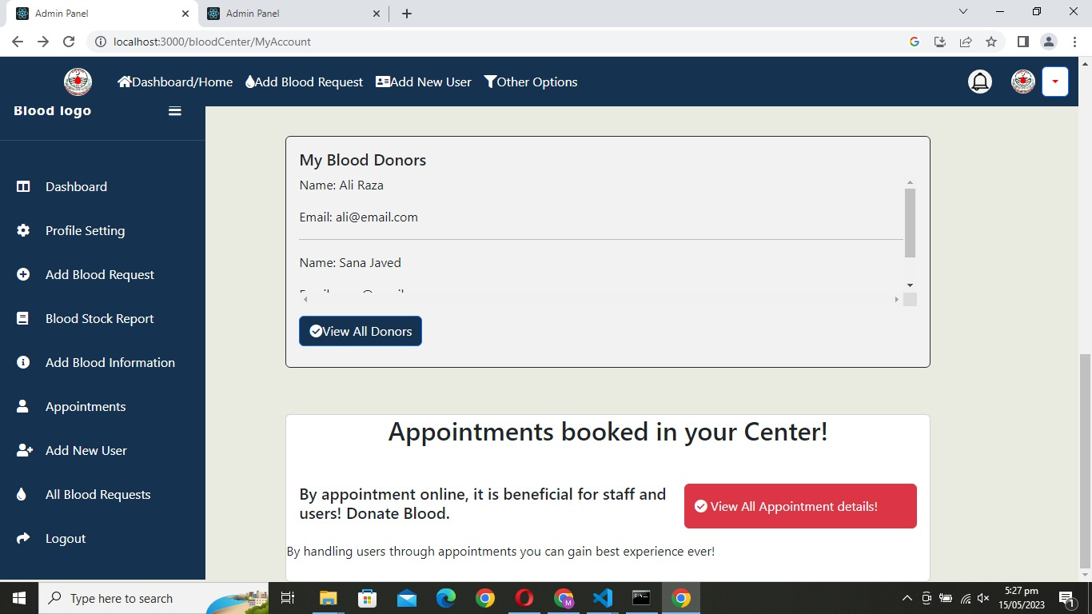
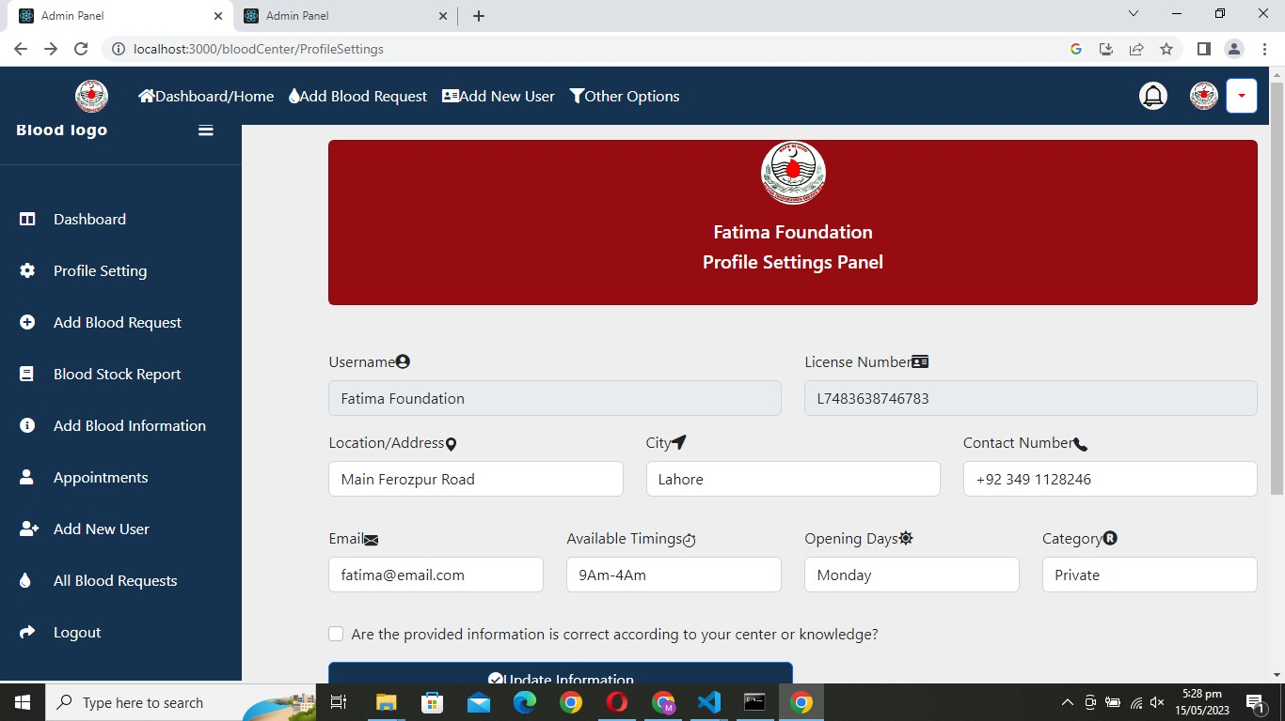
High Fidelity Prototypes
Blood Donation Centre Panel

Slide 30
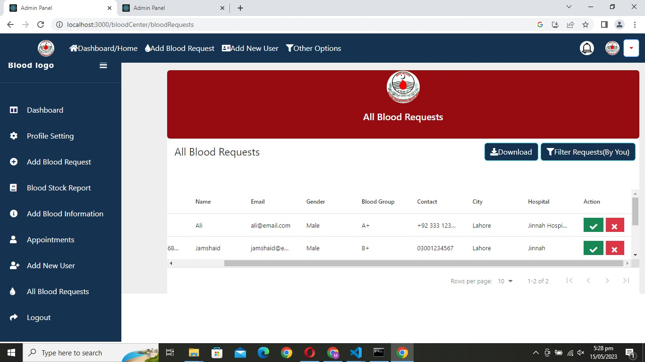
High Fidelity Prototypes
Blood Donation Centre Panel

Slide 31
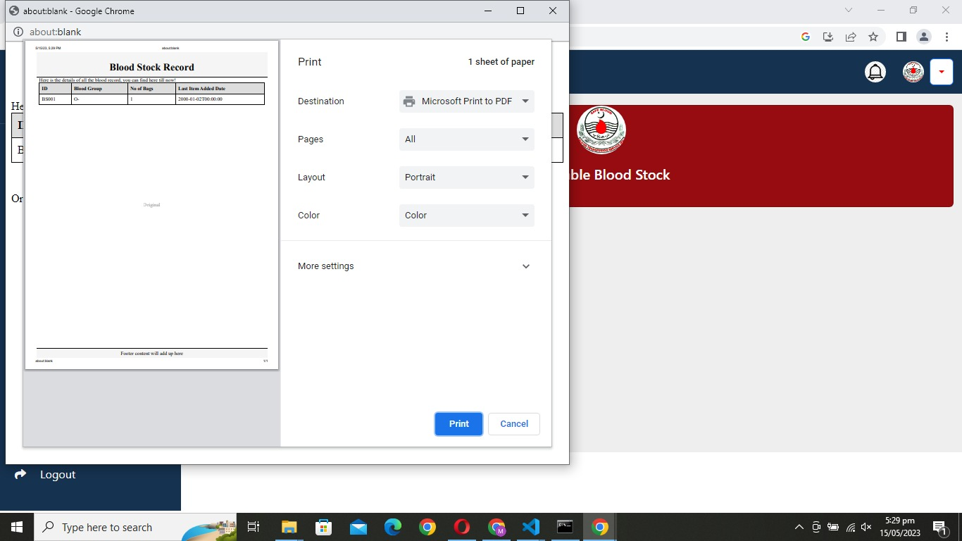
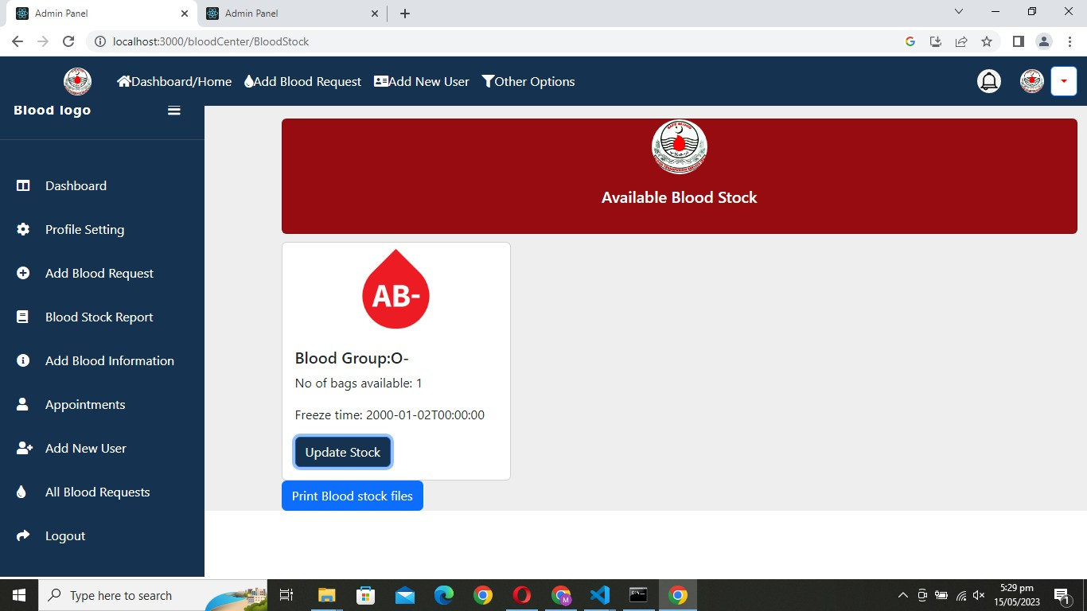
High Fidelity Prototypes
Blood Donation Centre Panel

Slide 32
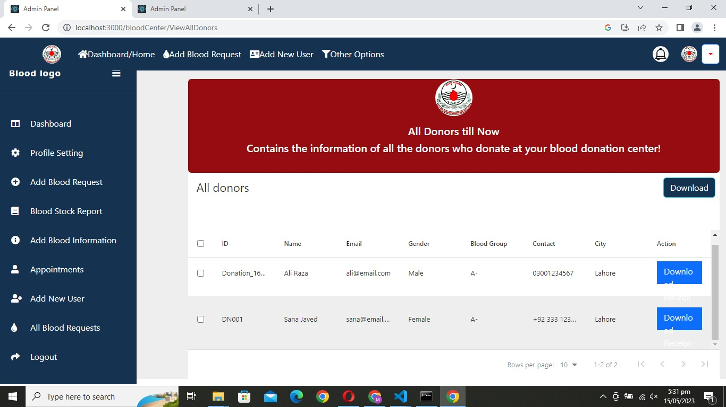
High Fidelity Prototypes
Blood Donation Centre Panel

Slide 33
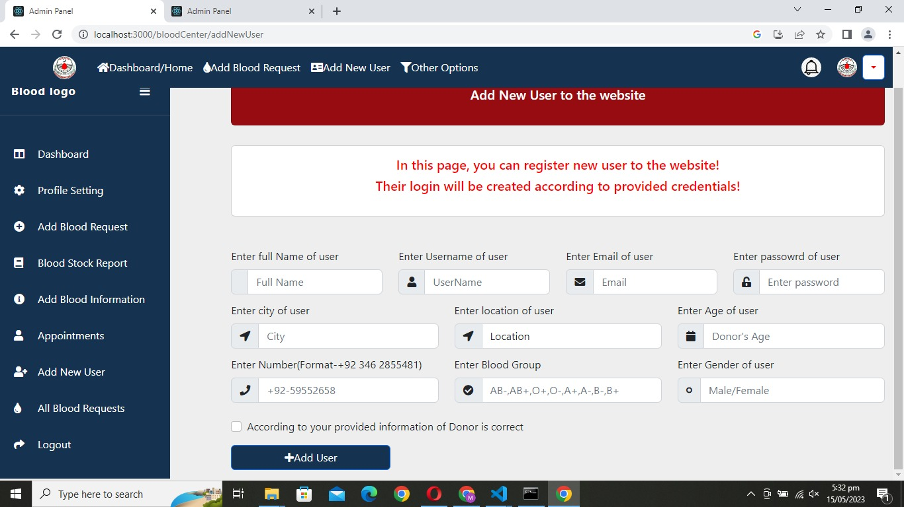
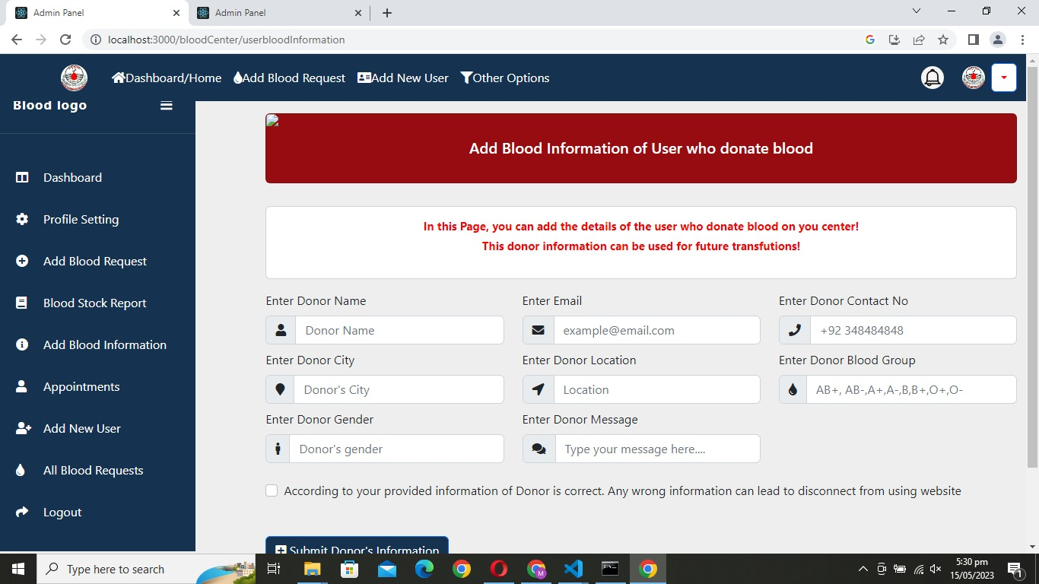
High Fidelity Prototypes
Blood Donation Centre Panel

Slide 34
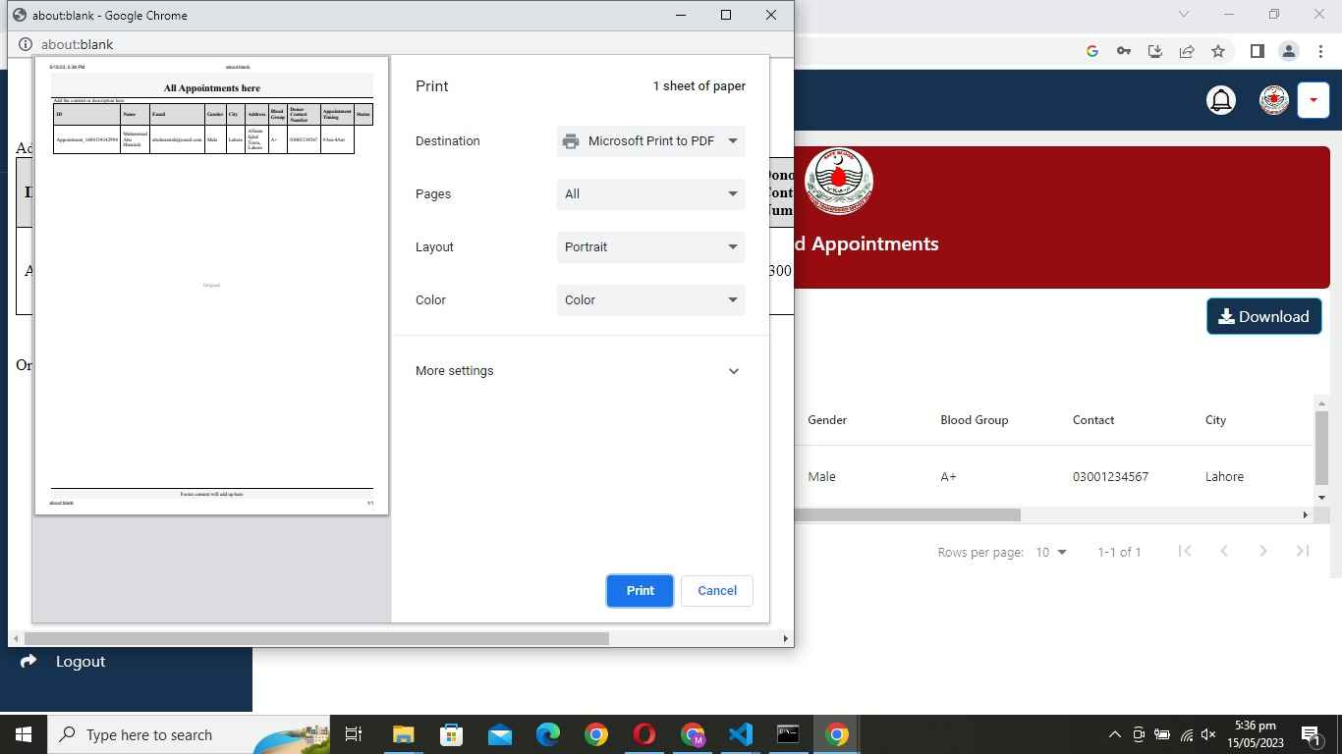
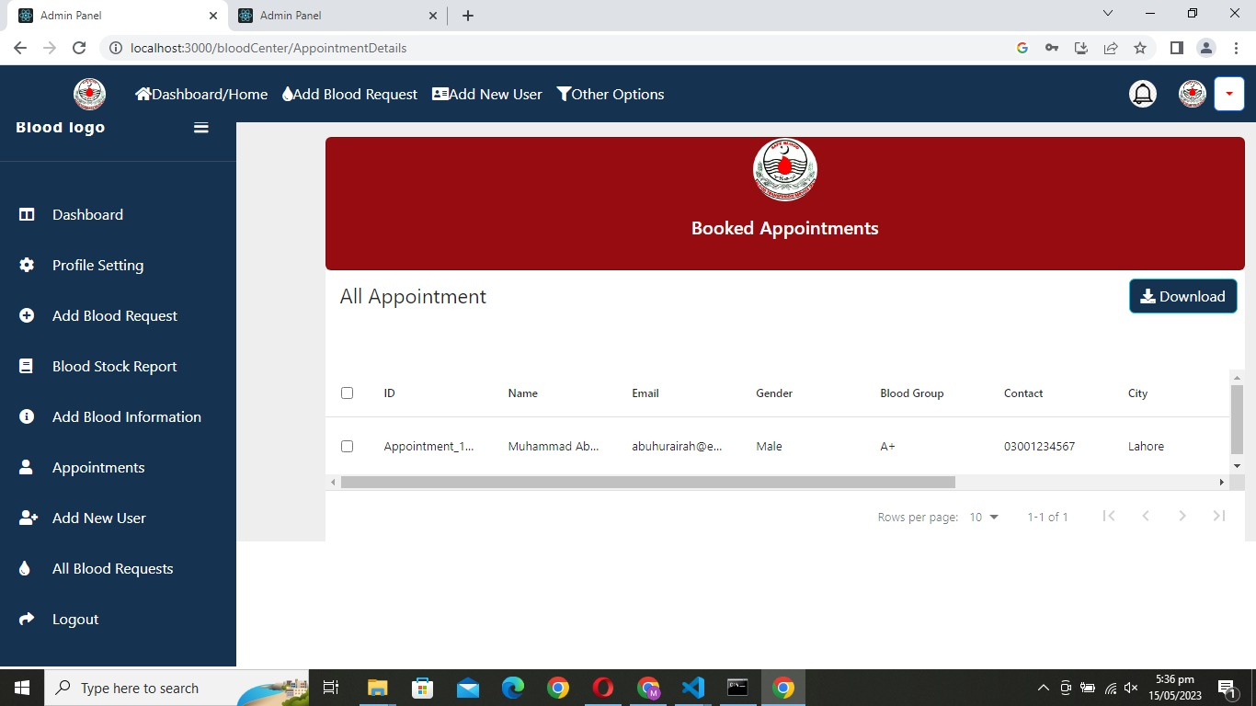
High Fidelity Prototypes
Blood Donation Centre Panel

Slide 35
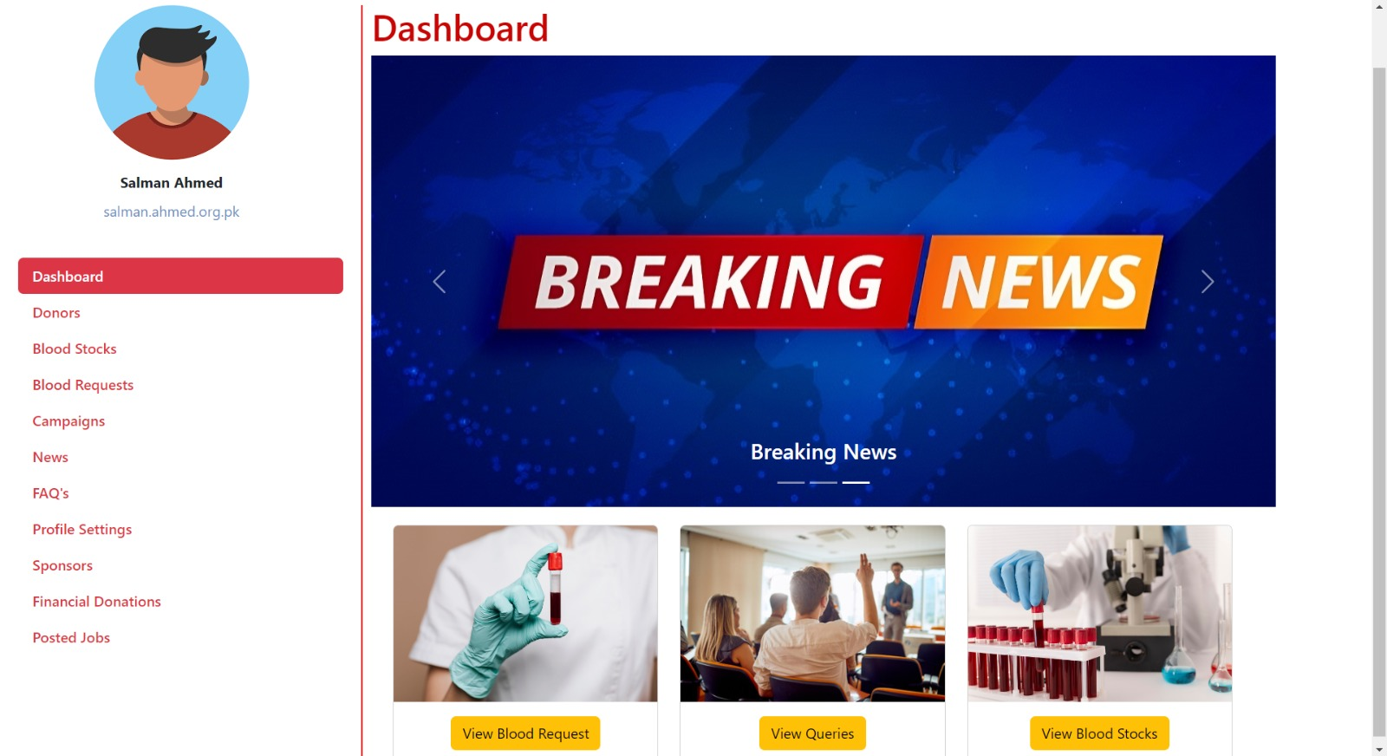
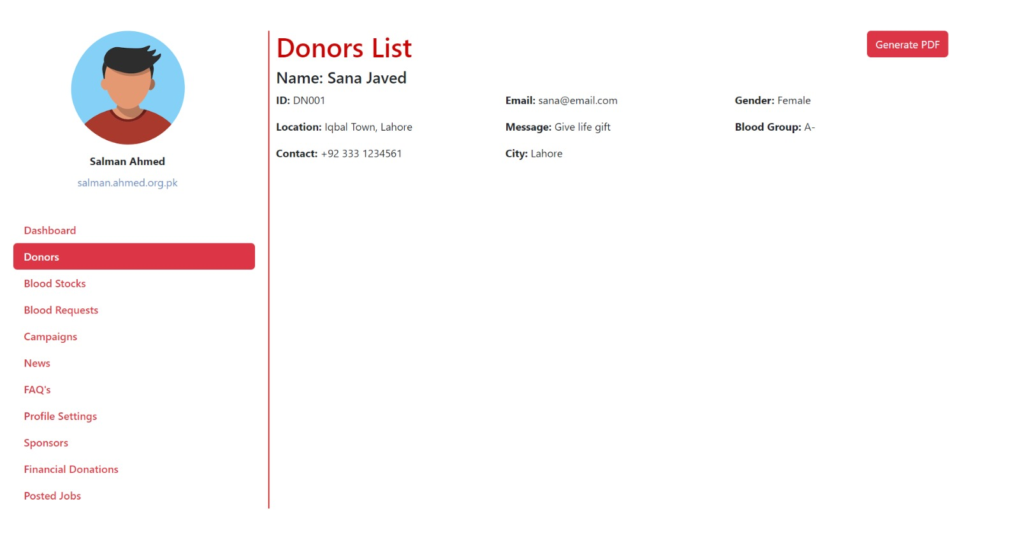
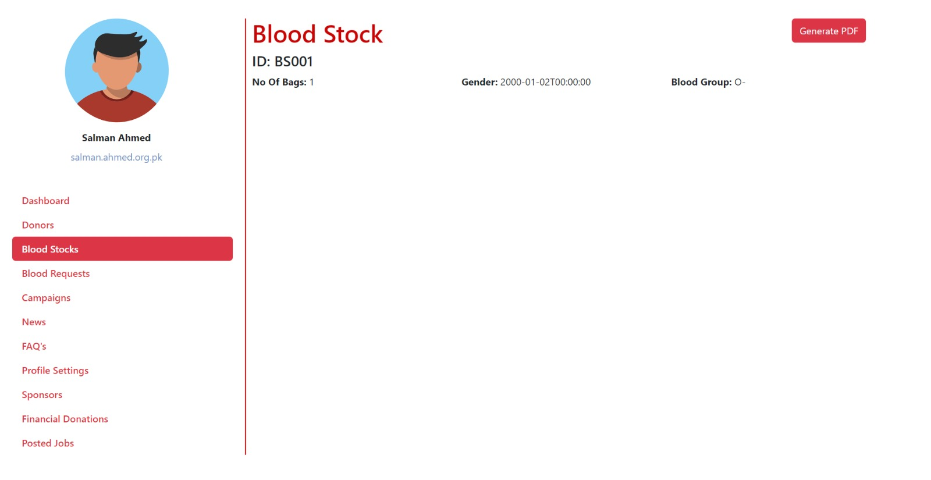
High Fidelity Prototypes
Admin Panel

Slide 36
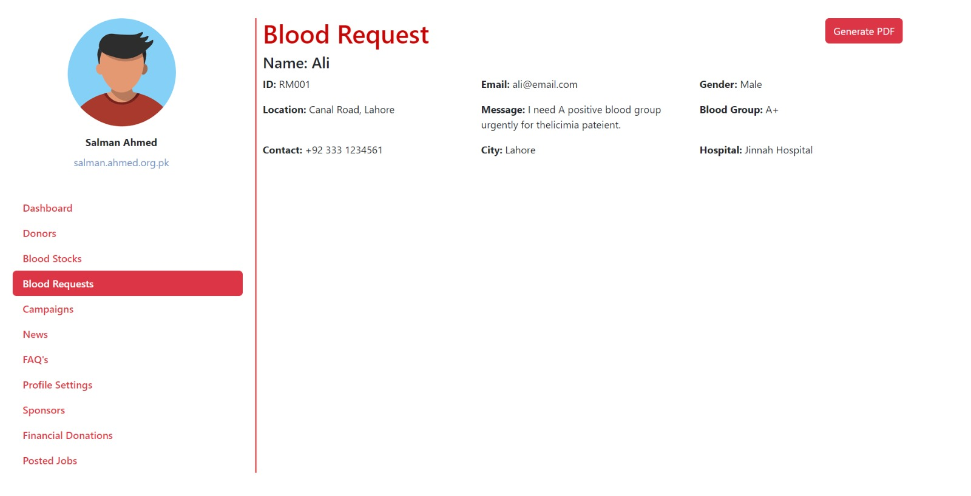
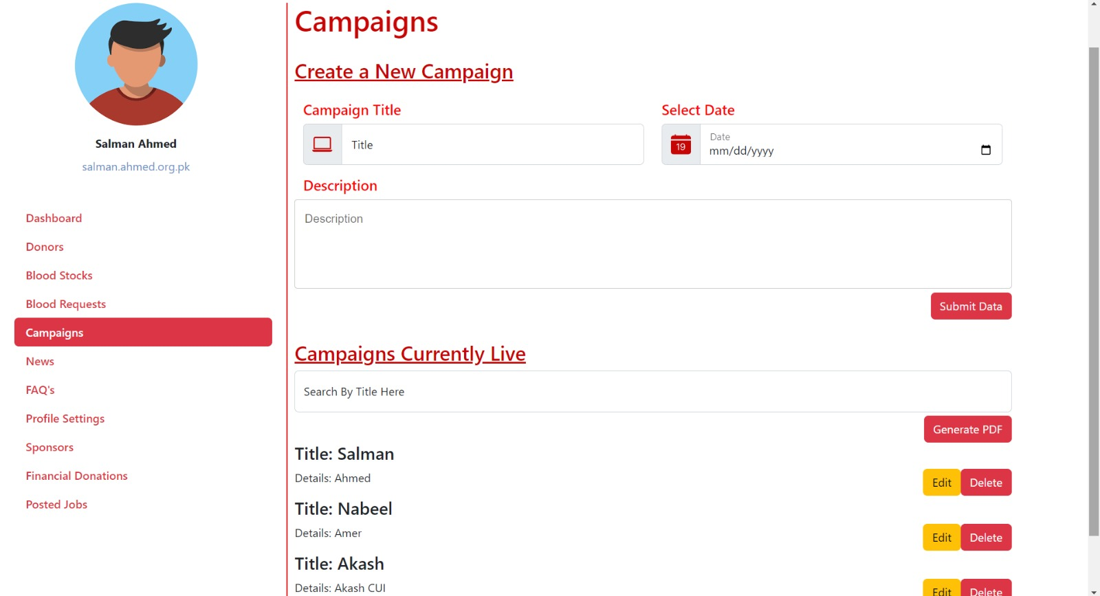
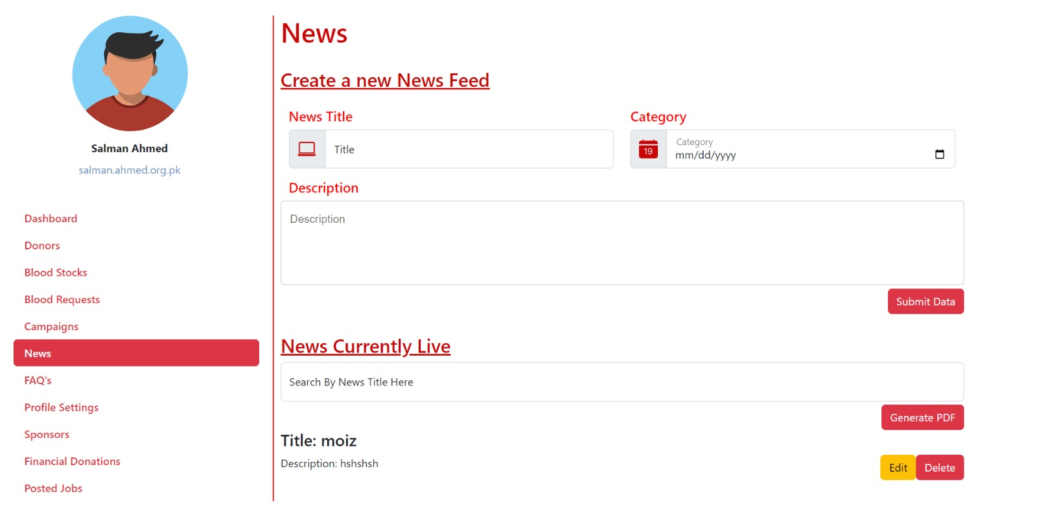
High Fidelity Prototypes
Admin Panel

Slide 37
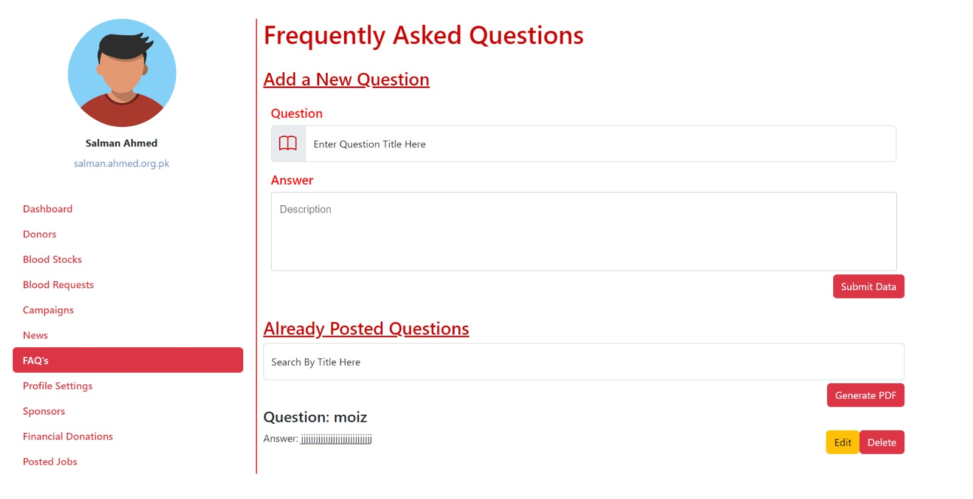
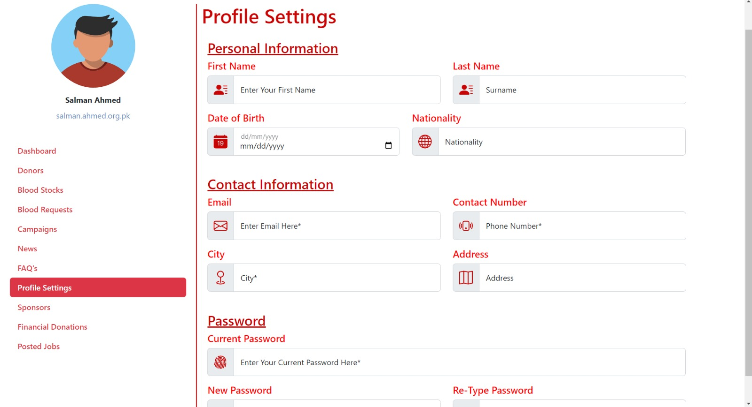
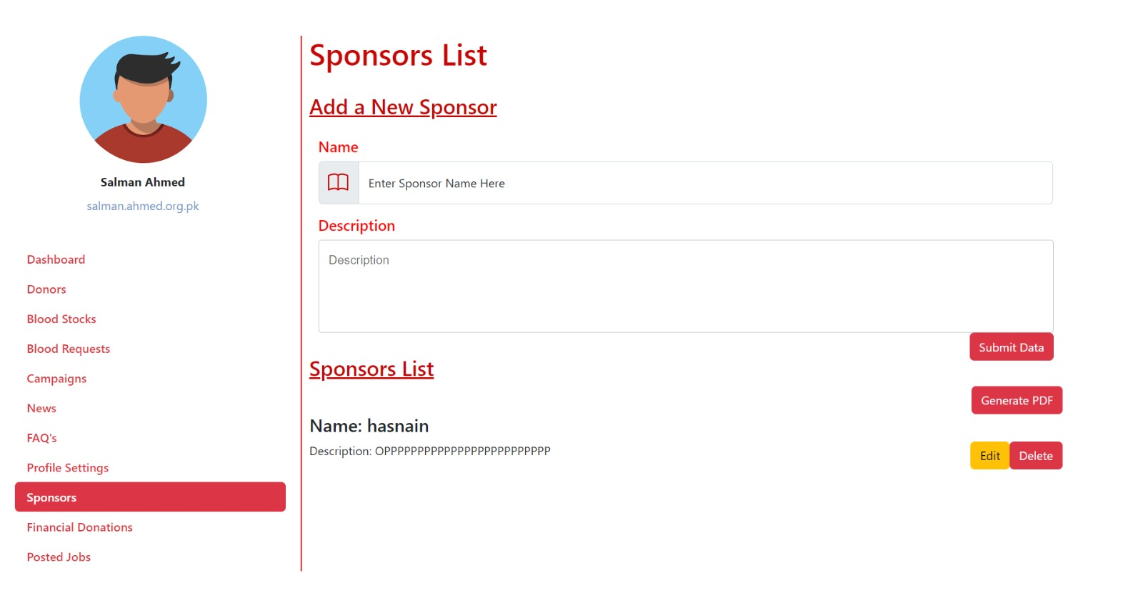
High Fidelity Prototypes
Admin Panel

Slide 38
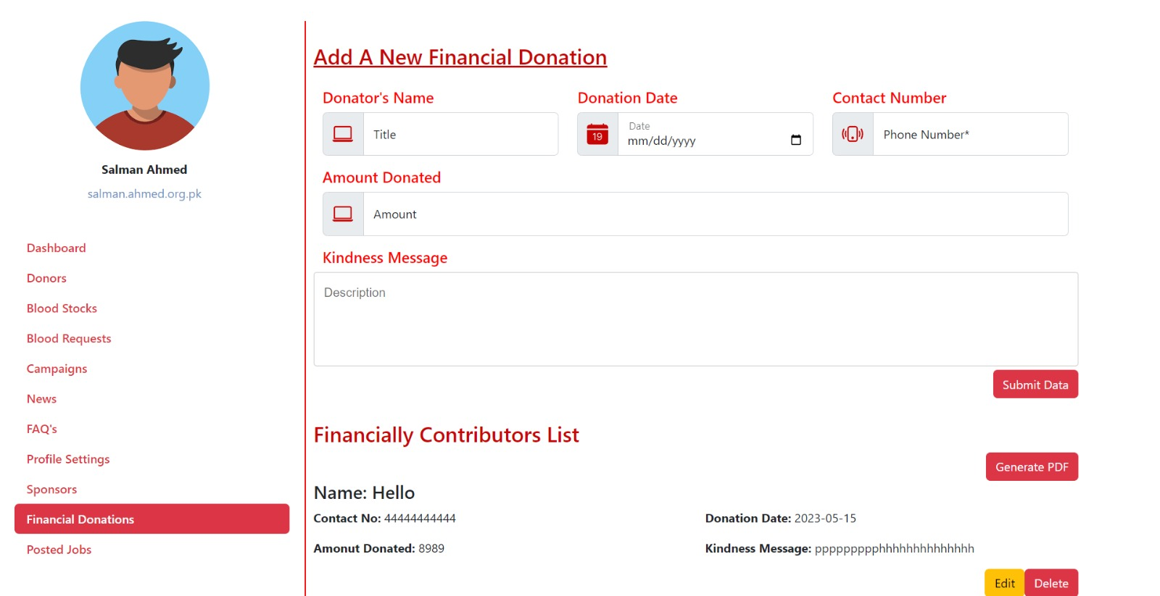
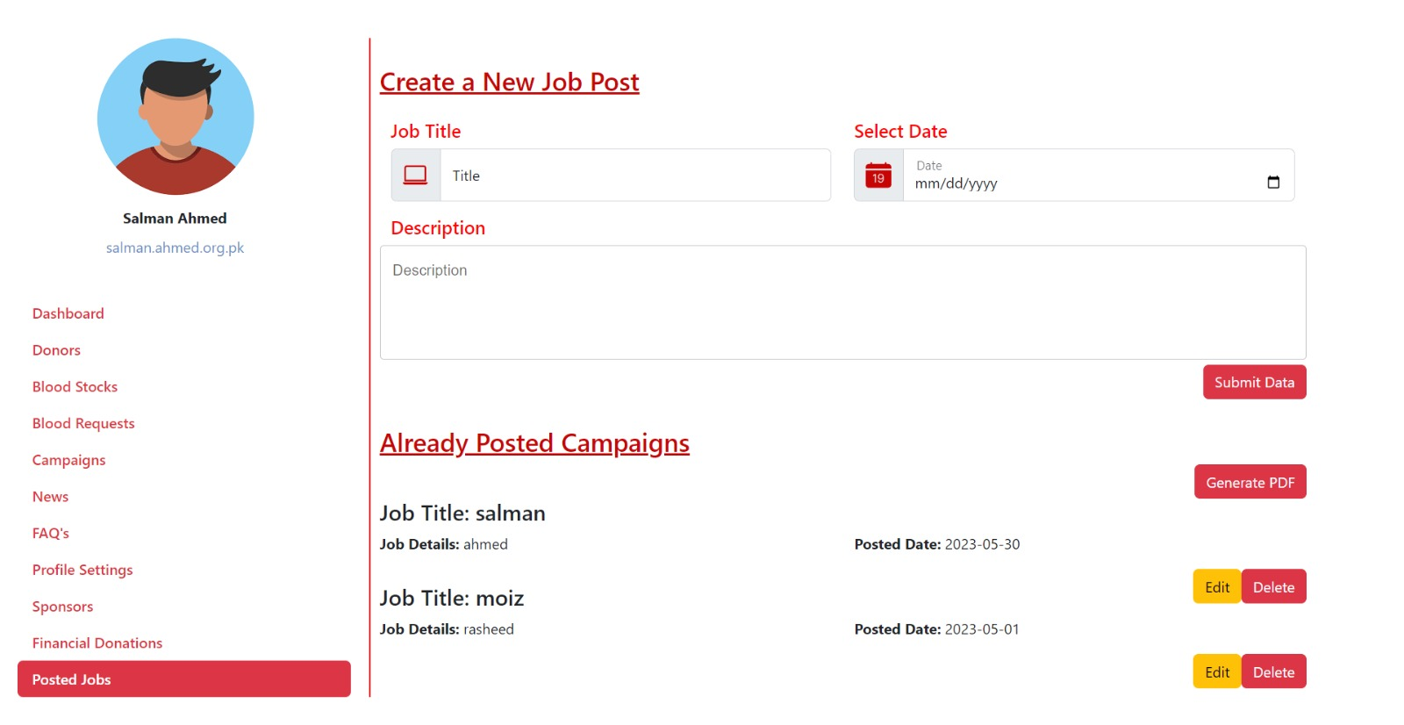
High Fidelity Prototypes
Admin Panel

Slide 39
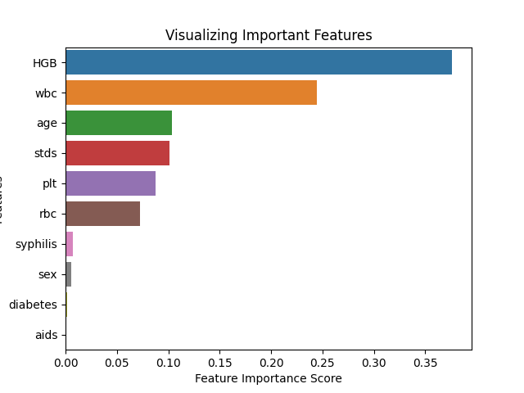
Backend Feature
Machine Learning

Slide 40
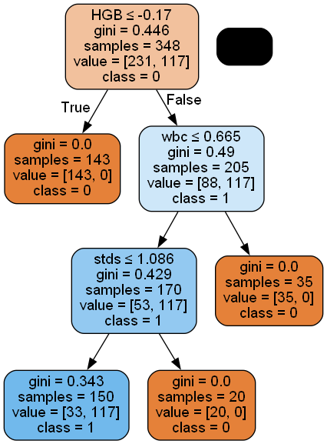
Backend Feature
Decision Tree

Slide 41
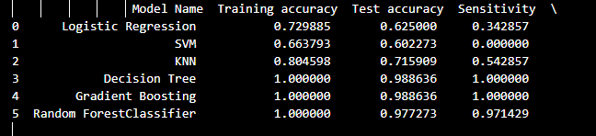
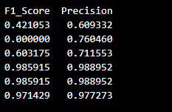
Backend Feature
Models

Slide 42
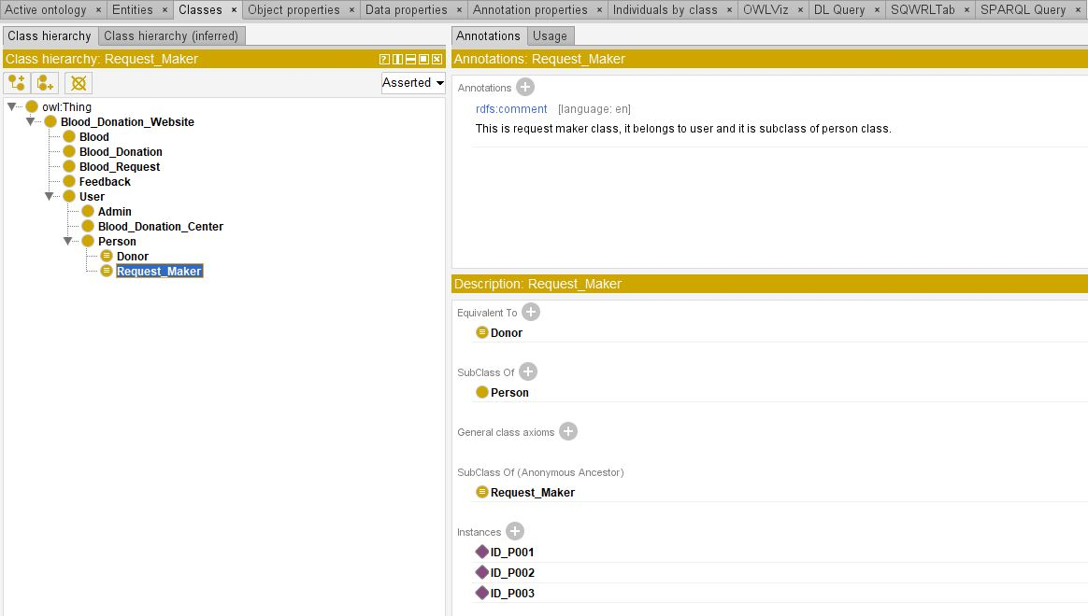
Backend Feature
Ontology Learning
Classes

Slide 43
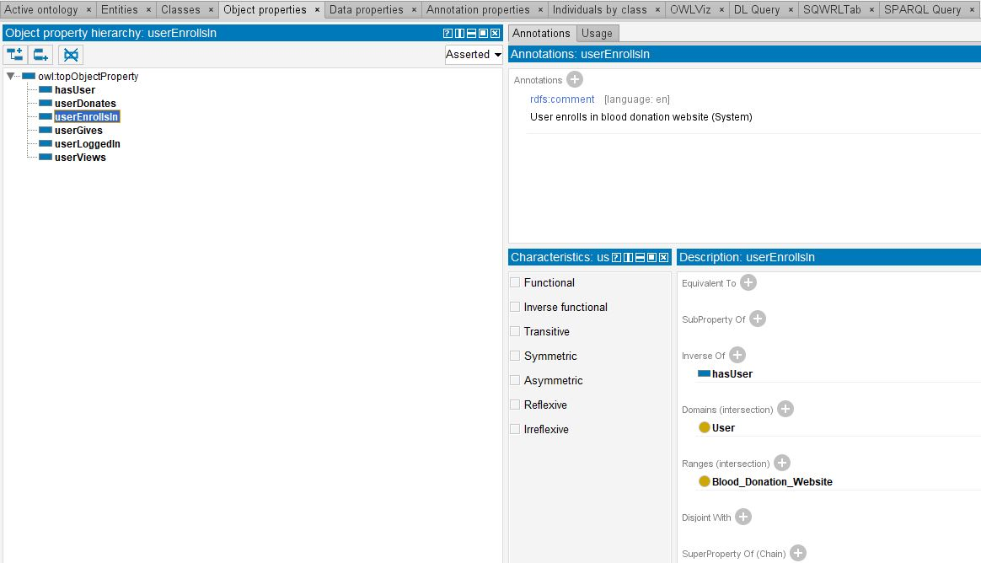
Backend Feature
Ontology Learning
Object Properties

Slide 44
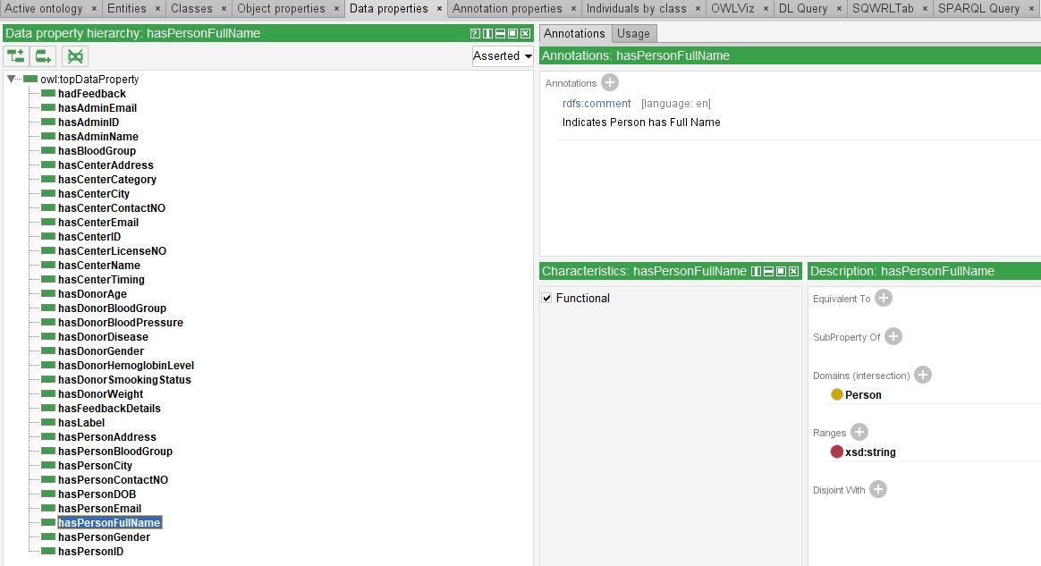
Backend Feature
Ontology Learning
Data Properties

Slide 45

Backend Feature
Ontology Learning
OWL Viz

Slide 46

Backend Feature
Ontology Learning
Define Individuals

Slide 47


Backend Feature
Ontology Learning
Sparql Queries

Slide 48
Database Diagram

Slide 49
Conclusion
Problems faced related to prototyping of system, collection of dataset for machine learning, and making consistent ontology.
Lessons we learned are how to achieve deadlines and team coordination
Implementing the machine and ontology learning so that system can learn its own
For future, development of mobile application and implementing machine learning for checking the blood samples

Slide 50
Research Paper
Overview:
The basic aim of developing this system or web Application is that users can also make the request for blood in any case and search for blood in the Blood banks. Patients can achieve the blood by contacting the donor through the internet or a personal contact number. As the study on the semantic web is progressing, many domain ontologies are being built.
Ontologies are built for variety of reasons ut the main purpose of building ontologies is to provide a specification of a particular domain in an explicit format. Ontologies serve as a common vocabulary for different people i.e. Stakeholders to communicate about a specific domain, providing a framework for capturing and sharing the knowledge. Researchers and developers are building ontologies based on their interests.

Slide 51
Research Paper
Overview:
Ontologies provide us with the help of integrating data from different sources by providing a shared understanding of that particular domain. There are various languages and tools that are used in making of ontologies, we have devised a method of manual merging of the ontologies by the help of SPARQL queries for web platforms.
SPARQL (SPARQL Protocol and RDF Query Language) is a standard query language used for querying data stored in RDF (Resource Description Framework) format. In the context of ontologies, SPARQL queries can be used to retrieve information from ontologies, which are also typically stored in RDF format.
Publication Link:
https://ejsit-journal.com/index.php/ejsit/article/view/174

Slide 52

Research Paper
Publication Certificate:
Publication Link:
https://ejsit-journal.com/index.php/ejsit/article/view/174

Slide 53
References
[1] S. T. C. R. B. A. Sinha S, “Haemoglobinopathies in India: estimates of blood requirements and treatment costs for the decade 2017-2026,” Journal of community genetics, vol. 11, no. June,11, pp. 39-45, 2020.
[2] M. M. Mostafa, “ Profiling blood donors in Egypt:A neural network anaylsis, Expert system with Applications,” vol. 36, no. 2009, pp. 5031-5038, 2009.
[3] D. K. Srivastava, Utkarsh Tanwar, M.G.Krishna Rao and Priya Manohar, “A Research Paper on Blood Donation Management,” International Journal of creative research thoughts, vol. 9, no. 5 May 2021, p. 8, 2021.
[4] Dr Usman Waheed, “Knowledge, Attitude and Practices towards Blood Donation in Pakistan: A Nationwide Survey”.
[5] Dr. Muneeba Azmat, “National Blood Donor Policy (2011) Safe Blood Transfusion Programme, Ministry of National Health Services, Government of Pakistan.”
[6] Hassan Abbass Zaheer, “ Inventory of Blood Donor Organizations (2012) Safe Blood Transfusion Programme, Ministry of National Health Services, Government of Pakistan.”

